Slide 1

Update on ASCN UK
Skin Terminology Project
A tool to increase the quality and accuracy in peristomal skin documentation
Wendy Osborne & Maddie White,
Ben McDermott, Anna Boyles,
Moira Evans; Rosie Callaghan, Dr. Calum Lyons

Slide 2
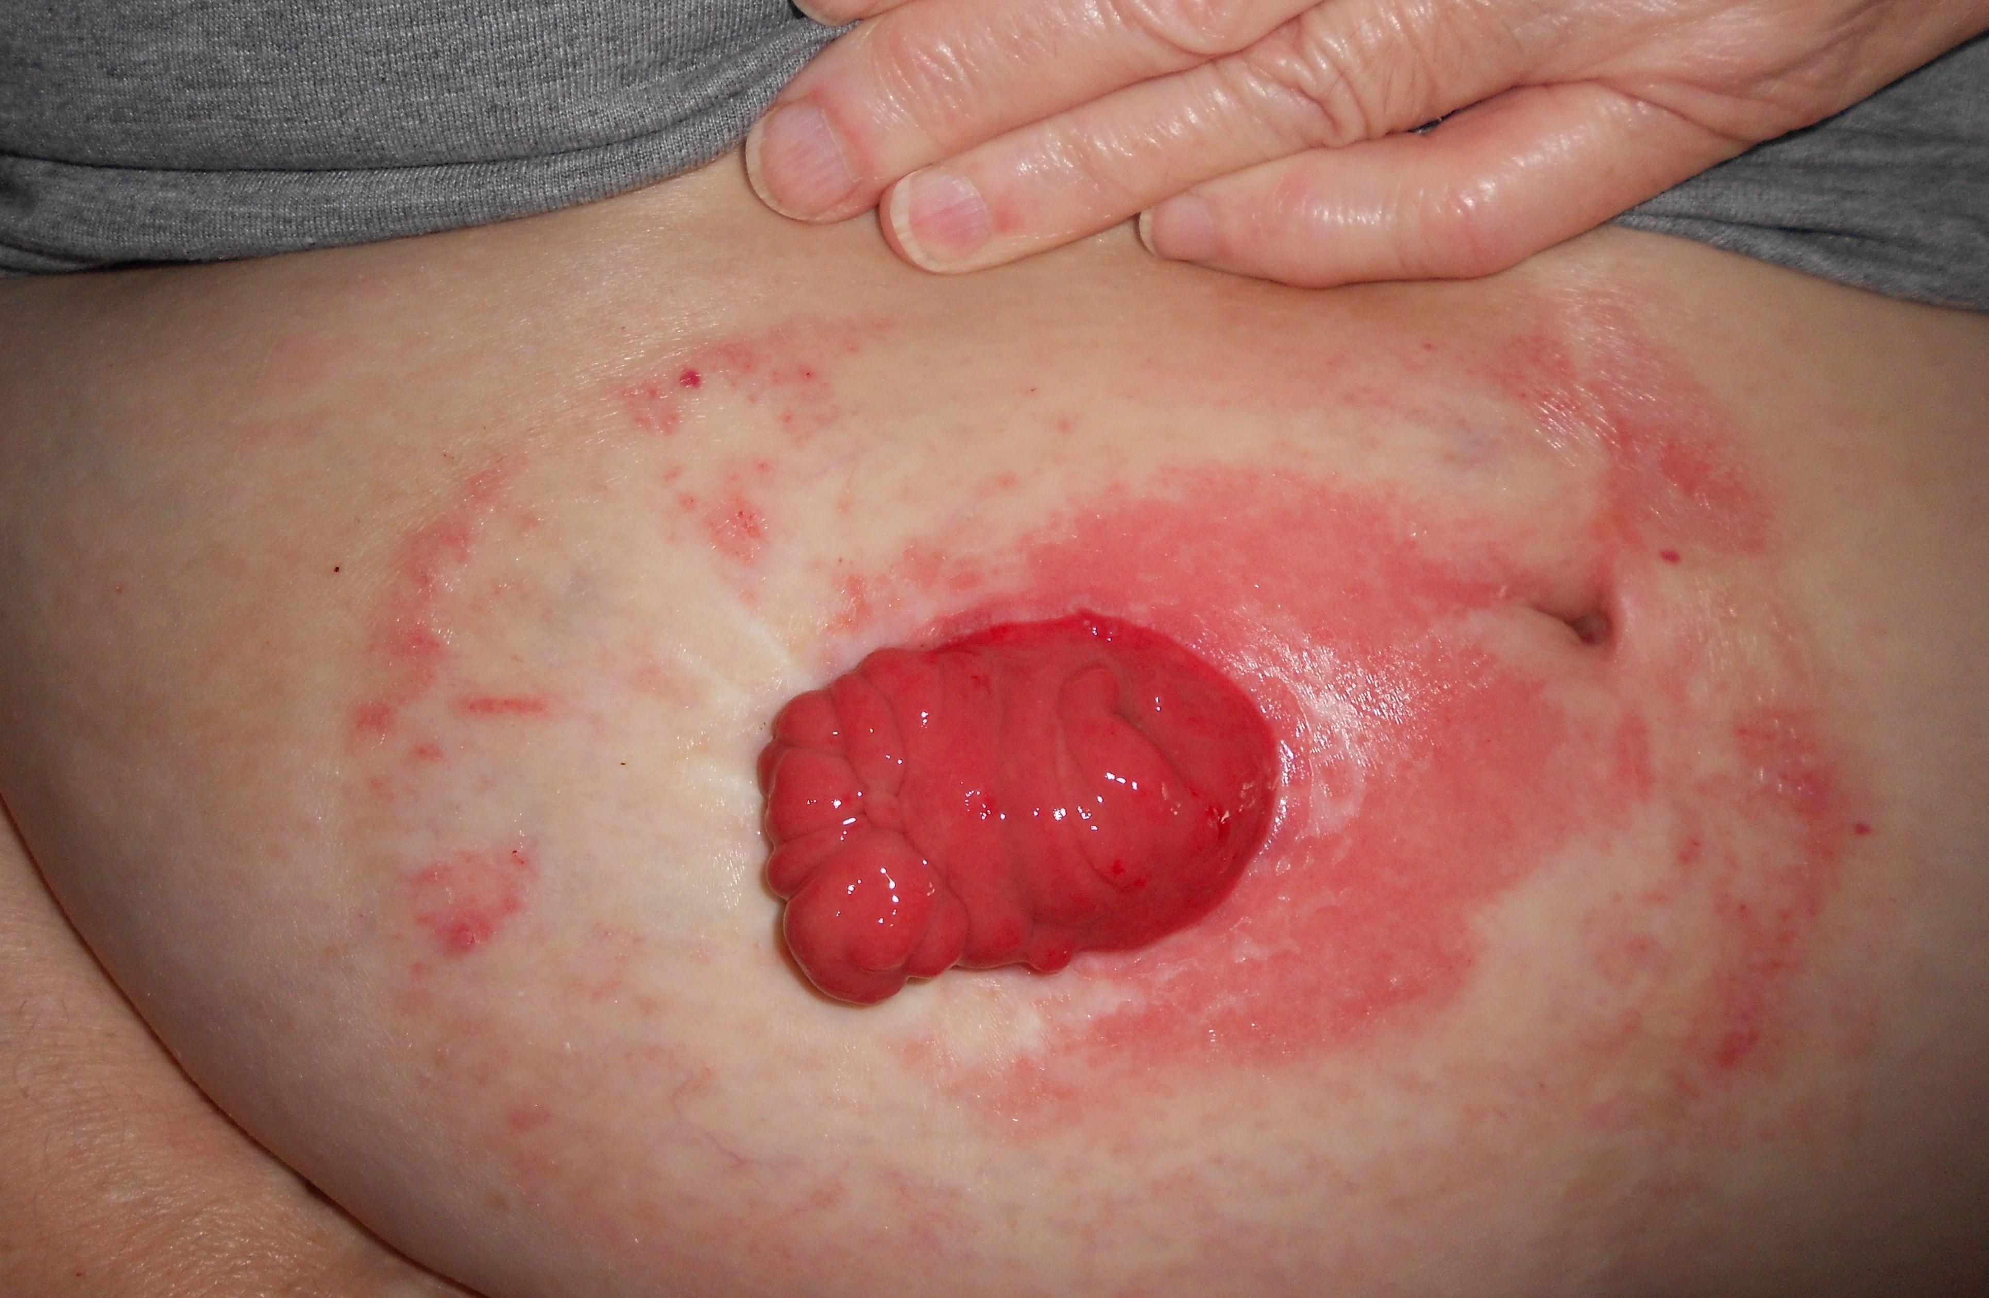

How do you document your peristomal assessment?
What we identified was:
The cause of the skin condition was documented but omitted the appearance of skin damage
No consistent structured approach was evident
The use of a skin tool provides an excellent overall assessment of the skin condition over time
Limited representation for different areas of peristomal skin damage ?

Slide 3
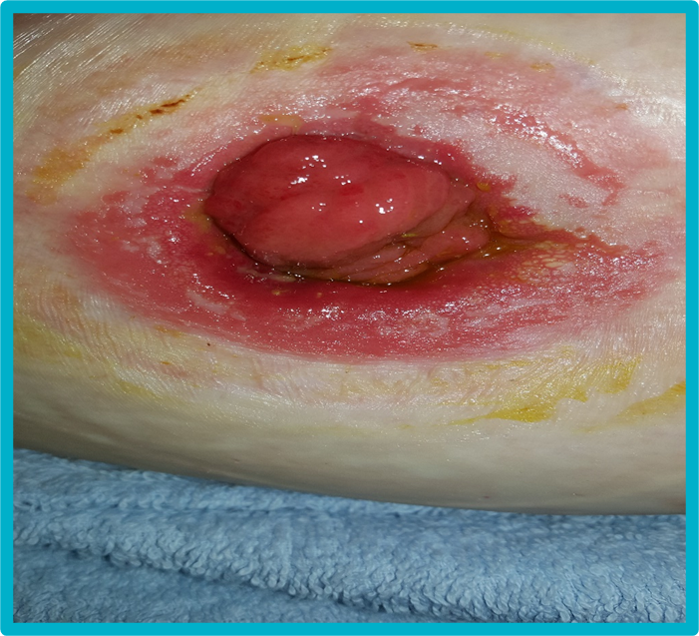
THE CHALLENGES HIGHLIGHTED
Subjectivity of observations
Variability & inconsistency in terminology
The need to manage & monitor the status of peristomal skin
Lack of reliable peristomal skin assessment tools
How we quantify skin damage
Complex chemical, physical and pathological processes
Interconnected aetiology

Slide 4
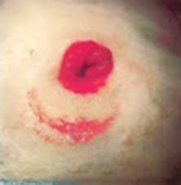

It is important to document what you see
This is the first part of your peristomal skin assessment - capturing and documenting what you see BEFORE you go into cause and treatment
Why is this important ?
  Promote effective communication through the quality of your documentation
  Encourage consistency of terminology between us as specialists and promote accuracy in the interpretation of our observations
  Supports clinical judgements, critical thinking & decision making based on your assessment
  Clearly document skin abnormality and demonstrate effectiveness to treatment
  Promote standardisation of how we as a professional body document our assessments
  This documentation adds value for your Skin scoring tool

Slide 5

SAY (Document) WHAT YOU SEE
Capture and document what is visually observed BEFORE scoring, considering the cause, classifying and deciding on management/ treatment
Why is this important ?
  Clearly document visual skin abnormality at the start of the assessment so that effectiveness to treatment can be identified and monitored
  Support clinical judgements and decisions based on your assessment
  Promote effective communication through the quality of documentation
  Promote standardisation of how we as a professional body document our assessments

Slide 6

Use of an acronym to prompt you
To assist guiding and enabling succinct documentation
To capture exactly the condition of the skin as seen on visual assessment
This is not a diagnostic tool it is an aide memoire
P.L.A.C.E.D
  Patient Describe skin lesion sensation by the patient
  Look Describe visual assessment of the peristomal skin
  Area Describe position & size of the peristomal skin lesion
  Colour Describe the colour of the peristomal skin lesion
  Extent Describe depth of the skin lesion
  Digit Describe the physical assessment of skin lesion

Slide 7
P.L.A.C.E.D | Peristomal Skin Tool prompts for structure and consistency in descriptions
Patient | Describe skin lesion sensation by the patient None; itchy; painful; burning; tingly
Look | Describe visual assessment of the peristomal skin Total number of lesions – sporadic; one area (describe each one) Flat – rash; dermatitis (skin inflammation) Raised – rash; over-granulation; dermatitis; plaque; water logged (macerated and oedematous); fluid filled (blister); papules Depressed – *ulcer Skin tear; prominent veins; defined or ill-defined edges
Area | Describe position and size of the peristomal skin lesion (use clock face to describe) Position – circumferential; mucocutaneous junction; peristomal (under adhesive), parastomal (periphery of appliance) Measure size – top to bottom and left to right (mm)
Colour | Describe the colour of the peristomal skin lesion Normal (compared to abdomen); red; shiny; hyperpigmentation; grey; bruising; blue/purple; translucent; white; yellow/green; black
Extent | Describe depth of the skin lesion Intact; erythema (blanching or non-blanching) Epidermal excoriation (skin lesion no bleeding); dermal excoriation (bleeding skin lesion); subcutaneous layer visible; *ulcer
Digit | Describe the physical assessment of skin lesion Dry; wet; heat; hard; pitting; turgid
*ulcer – risk of ulceration even when skin intact

Slide 8
P.L.A.C.E.D | Peristomal Skin Tool prompts for structure and consistency in descriptions
Patient | Describe skin lesion sensation by the patient None; itchy; painful; burning; tingly
Look | Describe visual assessment of the peristomal skin Total number of lesions – sporadic; one area (describe each one) Flat – rash; dermatitis (skin inflammation) Raised – rash; over-granulation; dermatitis; plaque; water logged (macerated and oedematous); fluid filled (blister); papules Depressed – *ulcer Skin tear; prominent veins; defined or ill-defined edges
Area | Describe position and size of the peristomal skin lesion (use clock face to describe) Position – circumferential; mucocutaneous junction; peristomal (under adhesive), parastomal (periphery of appliance) Measure size – top to bottom and left to right (mm)
Colour | Describe the colour of the peristomal skin lesion Normal (compared to abdomen); red; shiny; hyperpigmentation; grey; bruising; blue/purple; translucent; white; yellow/green; black
Extent | Describe depth of the skin lesion Intact; erythema (blanching or non-blanching) Epidermal excoriation (skin lesion no bleeding); dermal excoriation (bleeding skin lesion); subcutaneous layer visible; *ulcer
Digit | Describe the physical assessment of skin lesion Dry; wet; heat; hard; pitting; turgid
*ulcer – risk of ulceration even when skin intact
Notes:
Number of lesions (differentiates from the DET score
Ulcer – differentiate from pressure ulceration known by TVN’s – unique to peristomal area

Slide 9
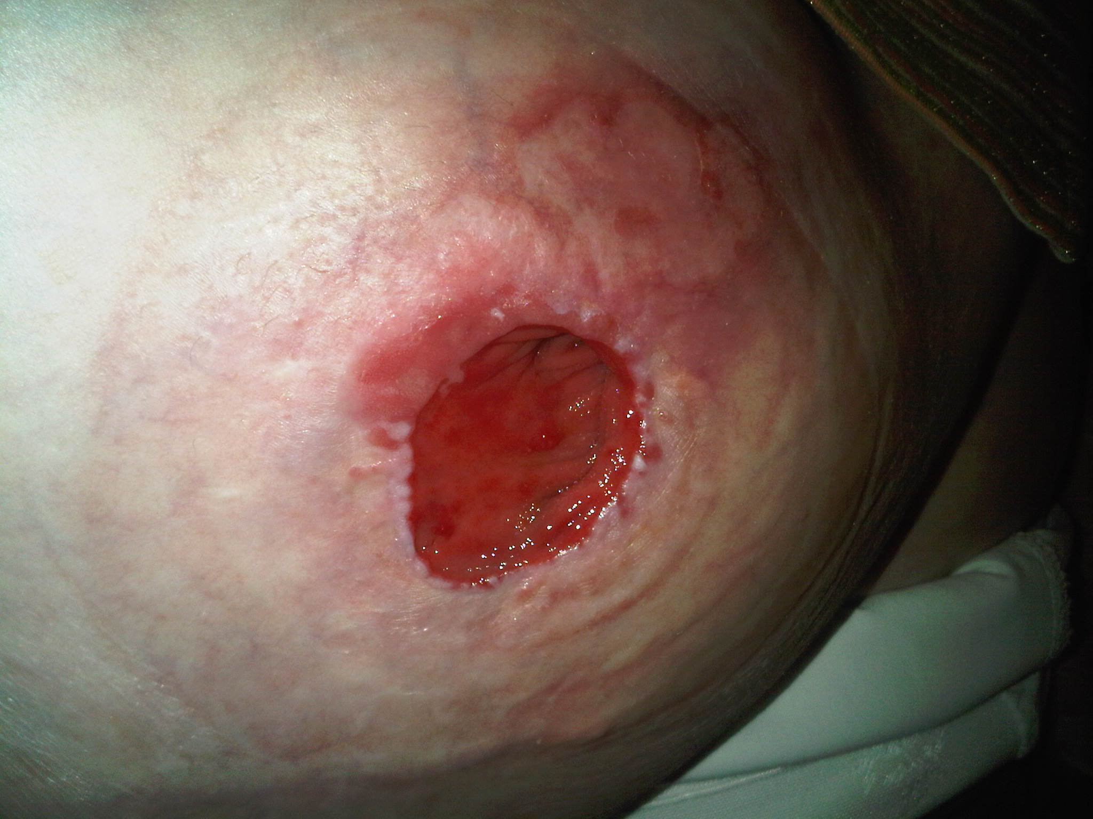
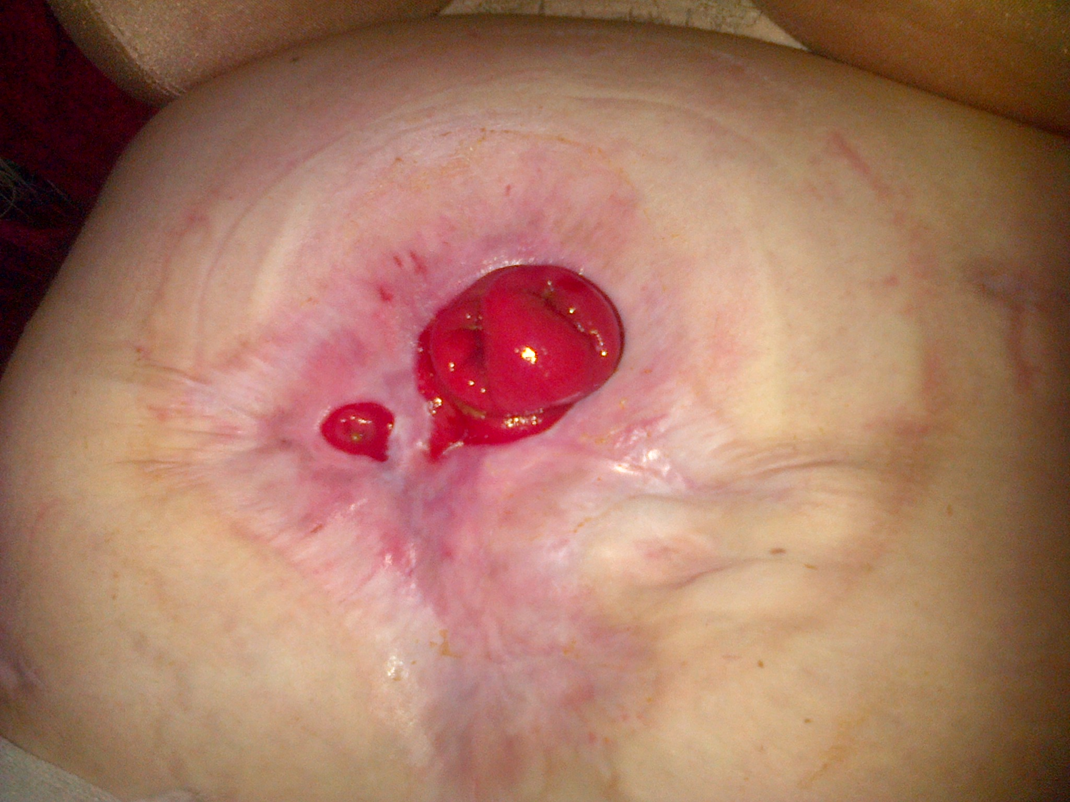
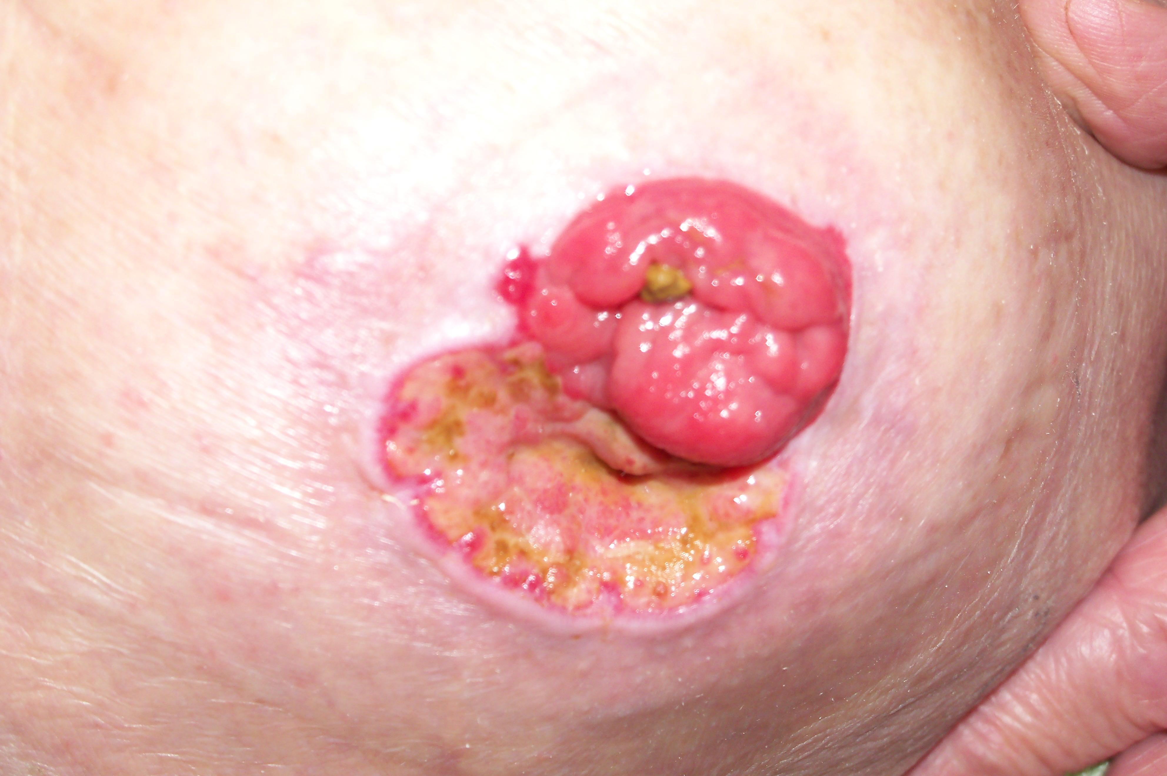
Proposal for classifying Peristomal Ulceration
Ulceration - loss of the layers of the epidermis and dermis and extending into the underlying tissue. In view of the uniqueness of peristomal ulceration this has been defined as;
Class 1 – At risk of ulceration developing - Appearance – see non blanching erythema
Class 2 - Peristomal Ulceration - Appearance - epidermis broken red, wet painful
Class 3 - Peristomal Ulceration – Appearance - damage to dermal layer and into subcutaneous layer; pain not constant

Slide 10
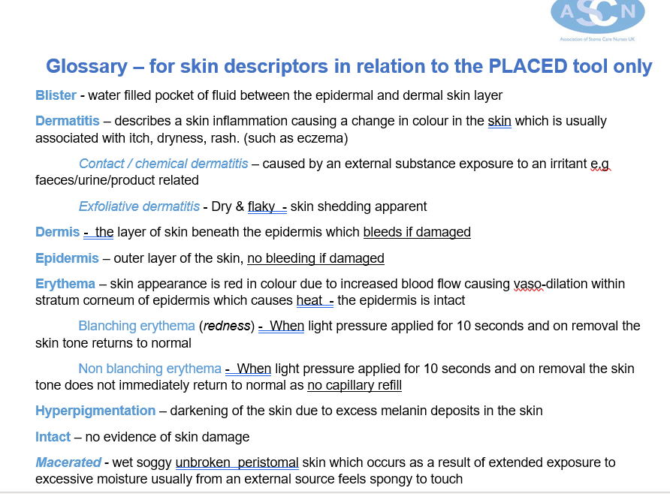

Slide 11
Peristomal Skin Tool
P.L.A.C.E.D.
Date:
Patient Name :
Nurse Name & Signature
Photo taken Y/N
  Patient Describe skin lesion sensation by the patient
  Look Describe visual assessment of the peristomal skin
  Area Describe position & size of the peristomal skin lesion
  Colour Describe the colour of the peristomal skin lesion
  Extent Describe depth of the skin lesion
  Digit Describe the physical assessment of skin lesion
12oclock
9
STOMA
3
6
Label all individual skin lesions on diagram
Area | P | L | A | C | E | D | Other comments
Mucocutaneous Junction
Peristomal – (under adhesive)
Parastomal – (outside adhesive)
Anywhere else (on the body)

Slide 12
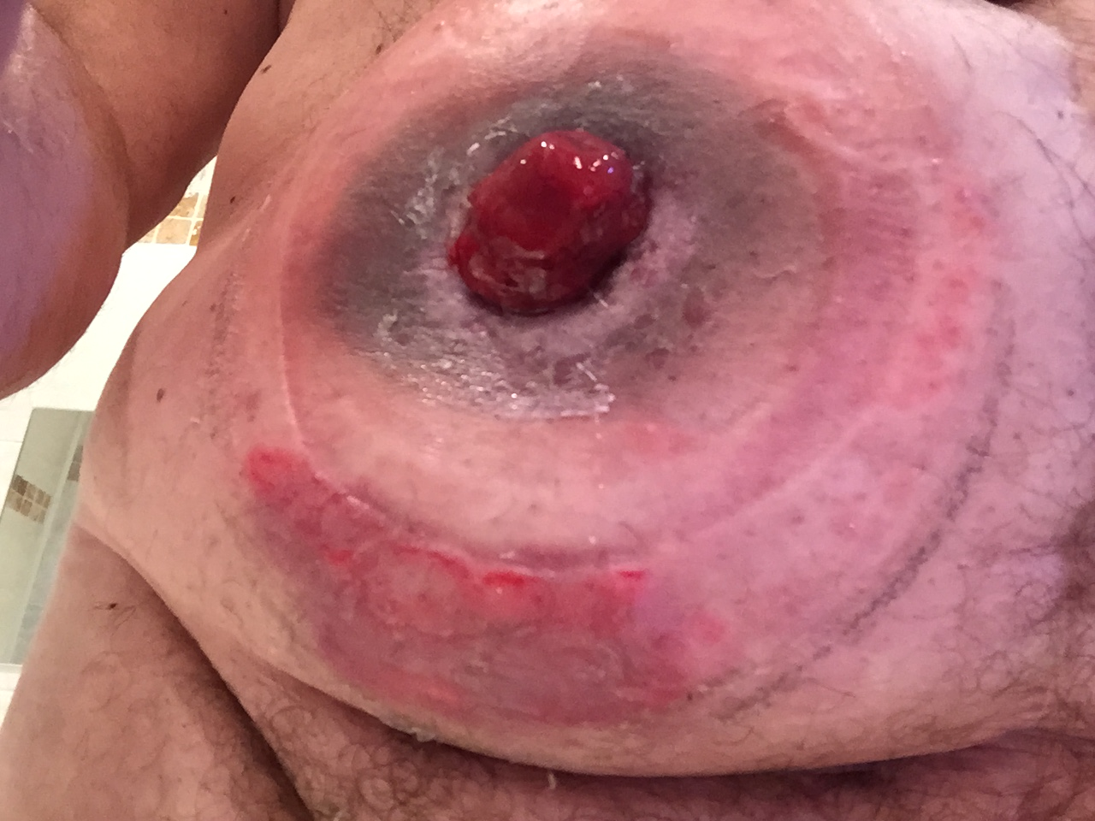
A
B
ZONE (MCJ /a/b/c) specify and label all individual abnormalities | P | L | A | C | E | D | Other comments
Mucocutaneous Junction
a) Peristomal – (under adhesive) | none | flat | Circumferential adjacent to stoma 15mm width | Grey staining | intact | dry
b) Parastomal – (outside adhesive) | sore | Flat dermatitis | 6oclock on periphery of appliance 2cm x 5cm | Red | Erythema - blanching | dry
c) Anywhere else (on the body)

Slide 13

The key message is - describe what you see
Capture and document what you see - BEFORE you identify cause and treatment
  Promote effective communication
  Encourage consistency & standardisation of terminology
  Support your clinical judgements, critical thinking & decision making
  Clearly document skin abnormality and demonstrate effectiveness to treatment
  Add value to your Skin scoring tool

